Slide 1

E-Commerce Sales Analysis
SRM INSTITUTE OF SCIENCE AND TECHNOLOGY
FACULTY OF ENGINEERING AND TECHNOLOGY
DEPARTMENT OF DATA SCIENCE AND BUSINESS SYSTEMS
21CSS202T FUNDAMENTALS OF DATA SCIENCE
- Project Review 2
RA2311056010078 – JEEL PATEL
RA2311056010097 – SARTHAK SHARMA

Slide 2
Table of contents
Abstract
Objectives
Architecture diagram
Sample Dataset

Slide 3
Abstract
Comprehensive dataset of e-commerce sales over the past year, including diverse product categories, pricing, customer reviews, and monthly sales data.
Enables in-depth analysis of market trends, customer behavior, and sales performance across 12 months.
Provides a holistic view of product performance, facilitating optimization of product listings, pricing strategies, and marketing efforts.
Useful for identifying top-performing categories, understanding the impact of pricing on sales and reviews, uncovering seasonal trends, and evaluating customer satisfaction.
Aims to support data-driven decision-making for improving business strategies, enhancing sales, and boosting customer satisfaction.

Slide 4
Objective
The primary objective of this dataset analysis is to uncover key insights related to:
Top-Performing Product Categories: Identify which product categories contribute the most to overall sales and customer satisfaction.
Pricing Strategy Optimization: Evaluate the correlation between product pricing and sales volume, as well as customer review scores, to refine pricing strategies.
Seasonal Sales Trends: Analyze monthly sales data to detect patterns and seasonality, enabling targeted marketing campaigns and inventory planning.
Customer Satisfaction Analysis: Assess the impact of review scores and review counts on sales performance, and identify areas for improvement in product quality or customer service.
These analyses aim to provide actionable insights that can help e-commerce businesses improve their product offerings, pricing models, and marketing tactics, ultimately driving higher sales and better customer satisfaction.

Slide 5
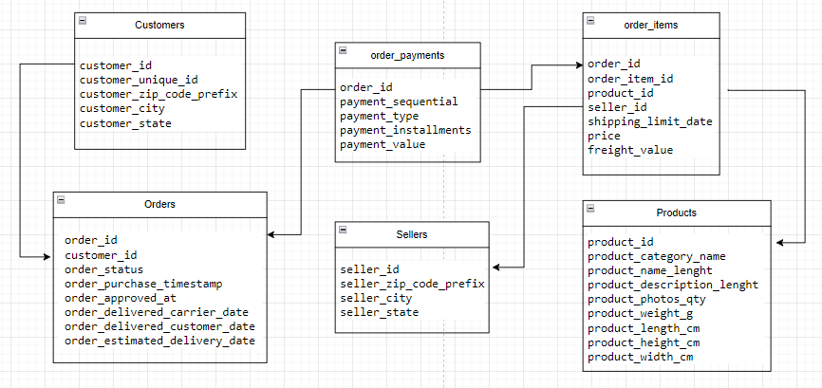
Architecture Daigram

Slide 6
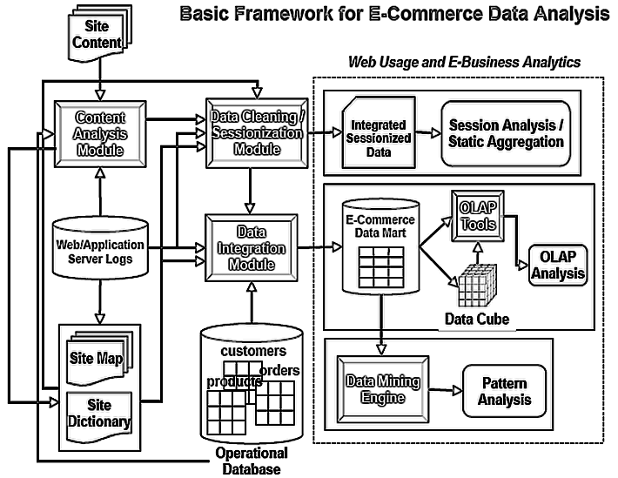
Architecture Daigram

Slide 7
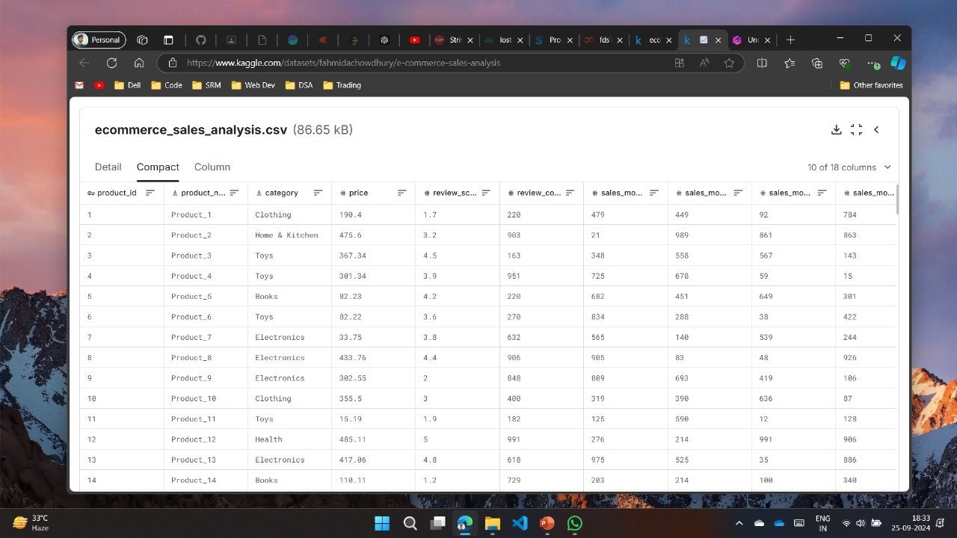
Sample Dataset

Slide 8
Thanks

